Slide 1
Data Analysis for Crime Recidivism
Zongjie Yin (zy347)
Chunyu Chen (cc2582)
Professor: Haiyun He

Slide 2
Content
Background
Data
Visualization
Machine Learning
Conclusion & Limitations
References

Slide 3
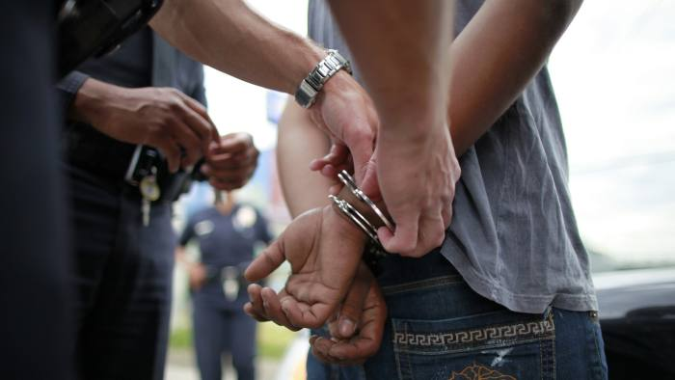

Background
In the US, judges determine a criminal's sentence based on their prior criminal record and the COMPAS score given by the COMPAS algorithm.
However, this system sometimes produces unreasonable or biased scores, which can mislead judges and lead them to make the wrong decision
We aim at helping the government better understand which inmates are likely to commit a subsequent crime.

Slide 4
Purpose
We will use the provided information to predict whether an individual criminal will reoffend within the next three years.
Ensure the accuracy of our recidivism predictions
Help to optimize the resources to track down criminals that are more likely recidivate

Slide 5
Data
Source: https://www.kaggle.com/datasets/uocoeeds/recidivism
Each row in the dataset represents one criminal history archived in the US criminal system
There are total 25,835 rows × 54 columns in the data set
Columns information includes:
criminal's intrinsic data : gender, race, education level...
crime activity data: prior crime type, prison offense type, risk score...

Slide 6
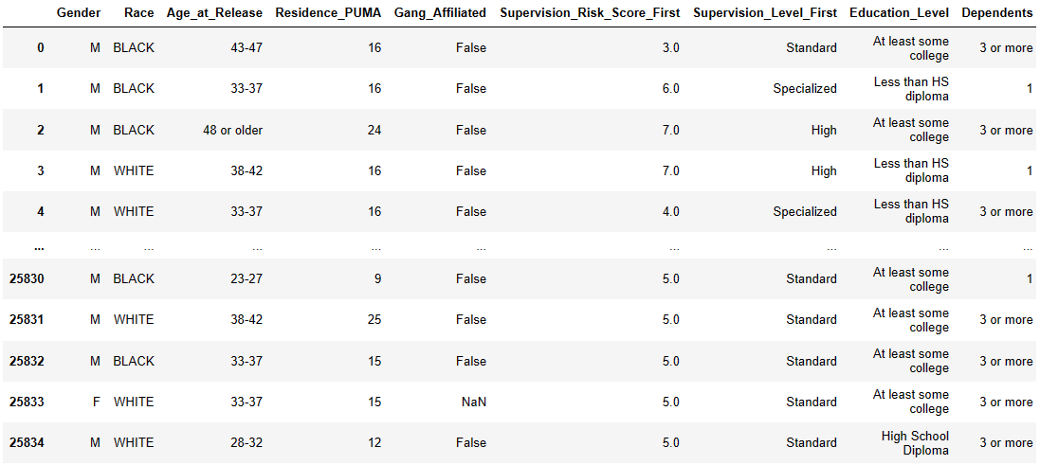
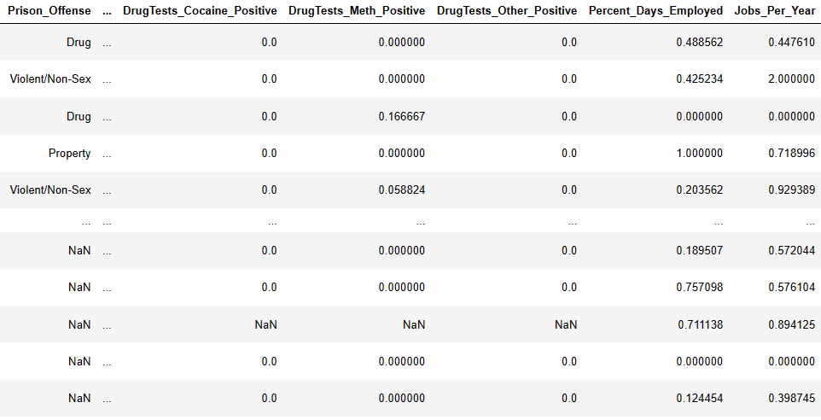
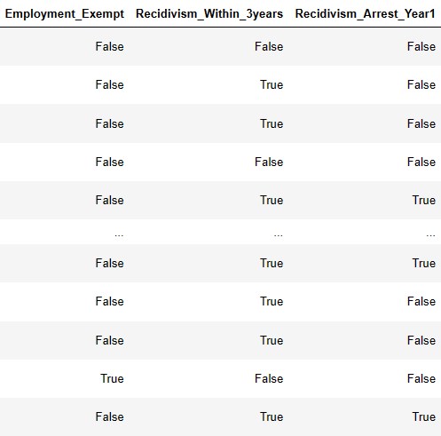
Example of data
Feature spaces: columns in the data-set (does not includes Recidivism_Within_3years)
Target variable: Recidivism_Within_3years

Slide 7
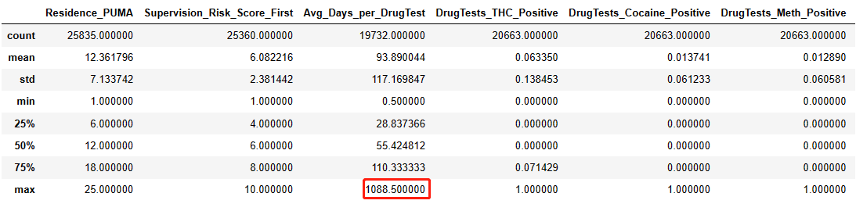
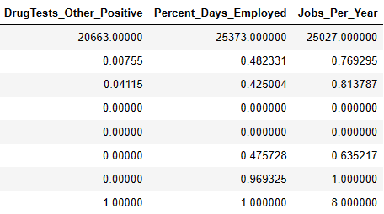
Data Cleaning
Outliers
Avg_Days_per_DrugTest
Jobs_Per_Year

Slide 8
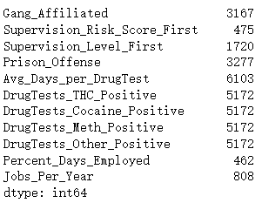
Missing values
Gang_Affiliated: mode
Supervision_Risk_Score_First: median
Supervision_Level_First: combination of risk score and mode
DrugTests: mode
Prison_Offense: “Other”

Slide 9
Questions to Explore
Whether the gender difference will affect the recidivation?
Whether the prior crime type will affect the recidivation?
Whether the risk score will affect the recidivation?
Whether the education level will affect the recidivation?
Is there any distinct pattern differentiate recidivation within next three years?
Whether we can predict the criminal recidivation in the next three years?

Slide 10
Visualization

Slide 11
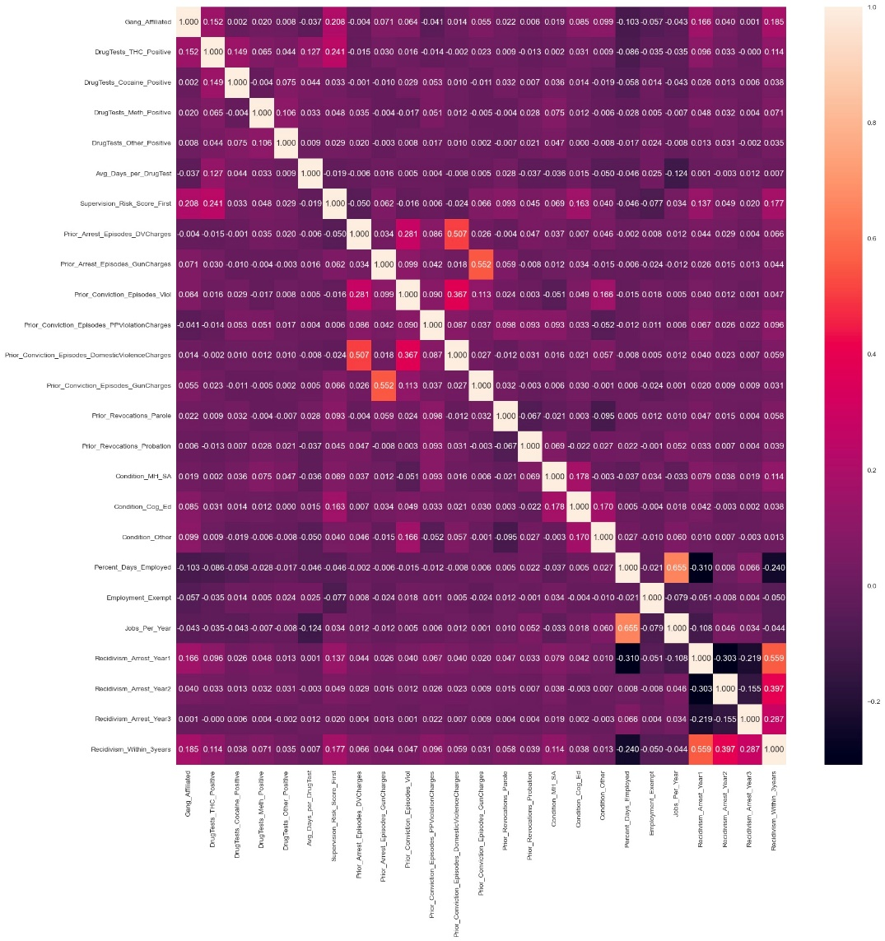
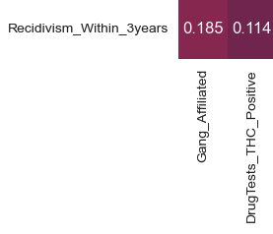



Correlation matrix

Slide 12
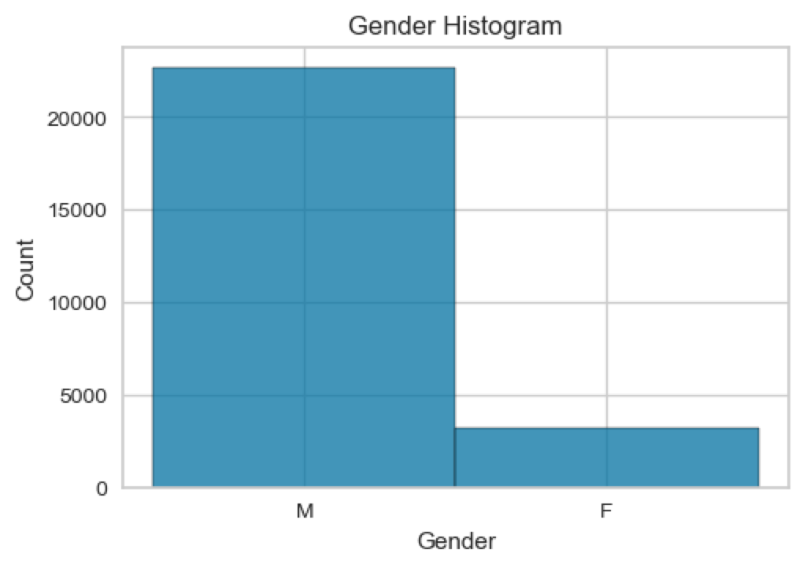
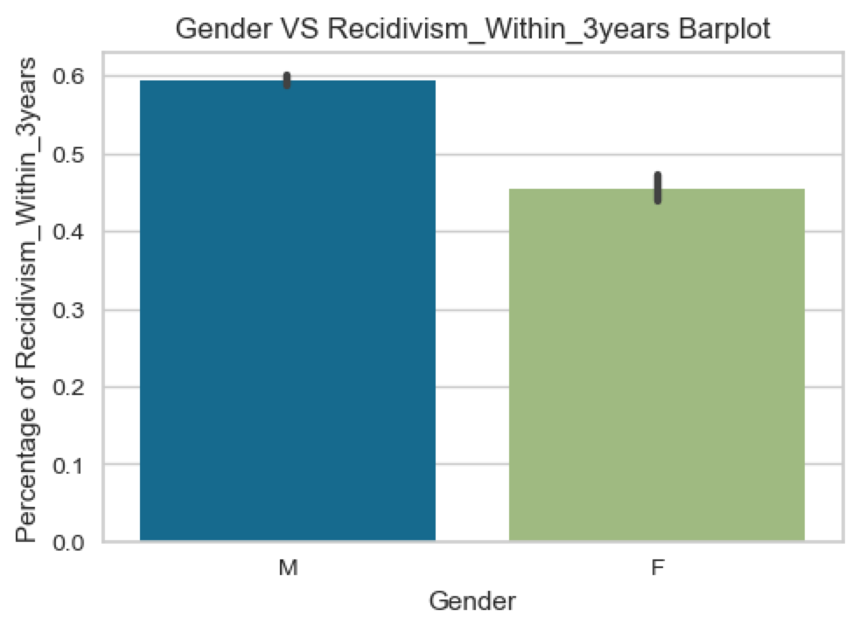
Gender VS Recidivism_Within_3years

Slide 13
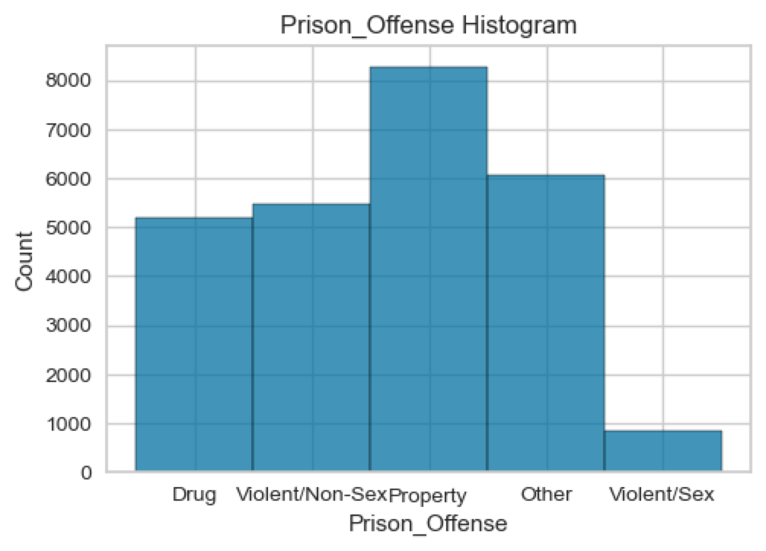
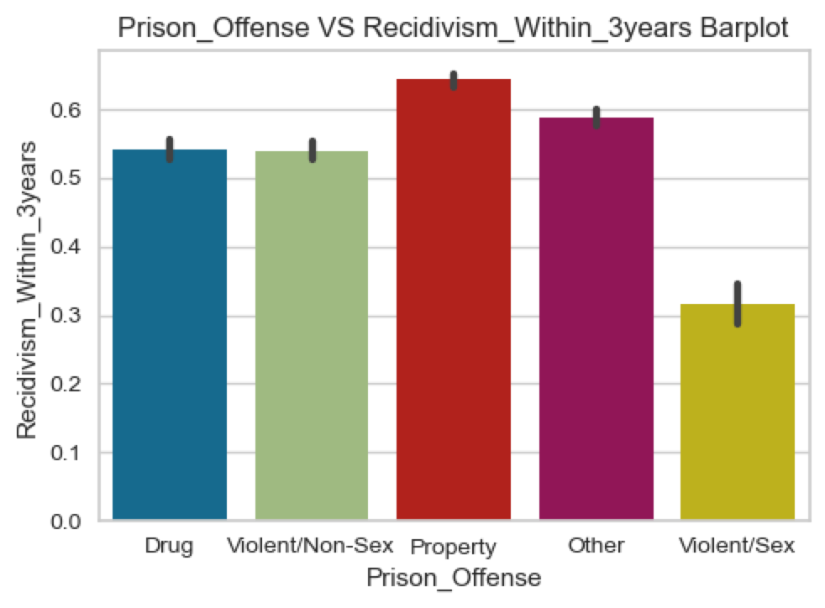
Prison_Offense VS Recidivism_Within_3years

Slide 14
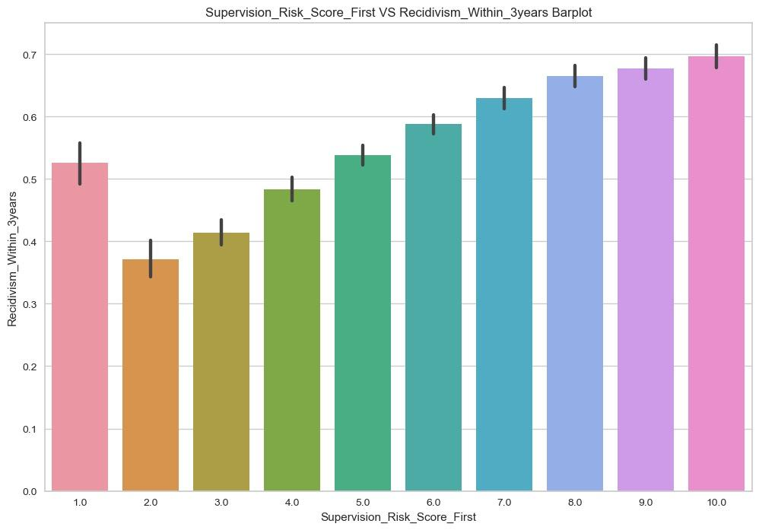
Supervision_Risk_Score_First VS Recidivism_Within_3years

Slide 15
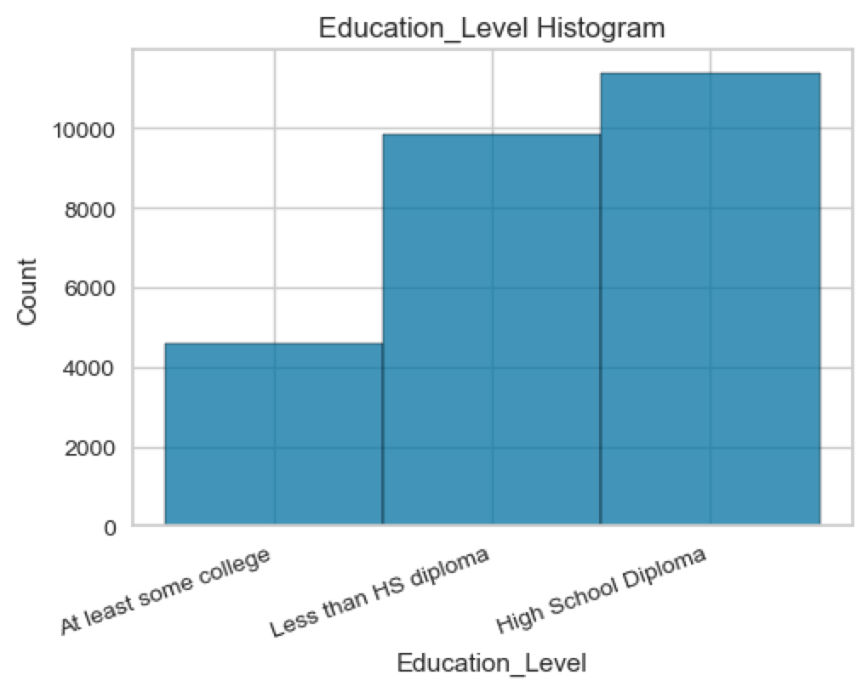
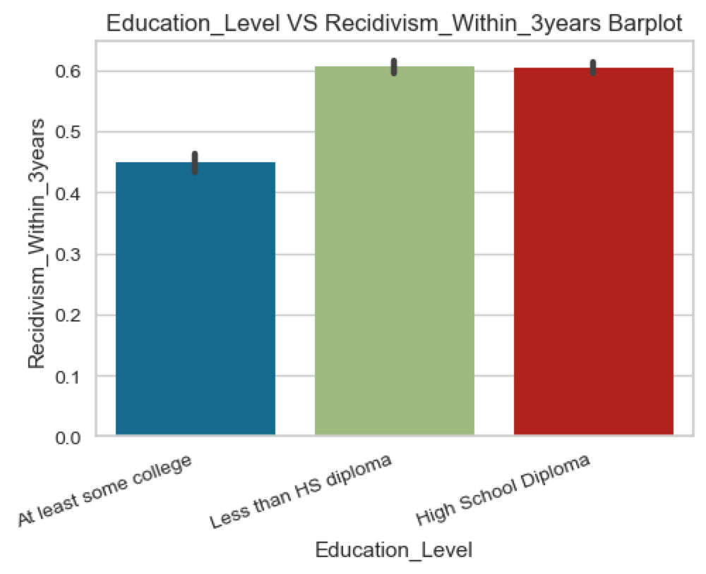
Education Level VS Recidivism_Within_3years

Slide 16
Machine Learning

Slide 17
Model Measurement
Metric: Recall
Fraction of positives that were correctly identified.
Recall = TP/(TP+FN)
Each model run 100 times to get histogram of recall
Grid Search: Find the best hyperparameter set
Cross Validation: Improve the stability and robustness of our models
All the data will split into 20% as test set and 80% as train set

Slide 18
Data Preprocessing
Standardize all the numerical variables
['Residence_PUMA', 'Supervision_Risk_Score_First', 'Avg_Days_per_DrugTest', 'DrugTests_THC_Positive', 'DrugTests_Cocaine_Positive', 'DrugTests_Meth_Positive', 'DrugTests_Other_Positive', 'Percent_Days_Employed', 'Jobs_Per_Year']
Using one hot encoding to transform categorical variables into matrix form

Slide 19
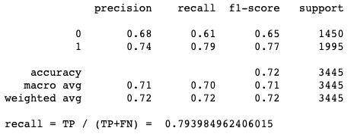
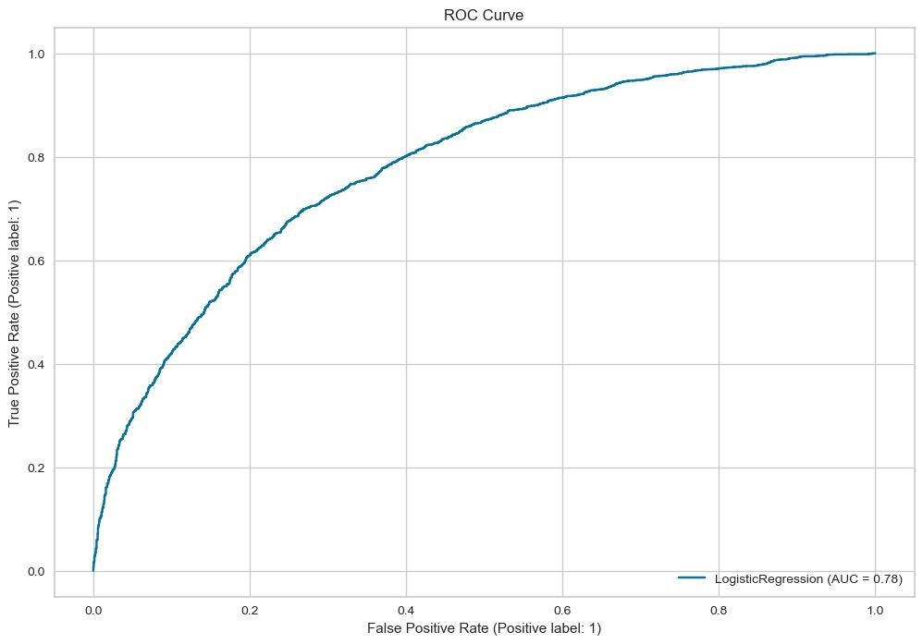
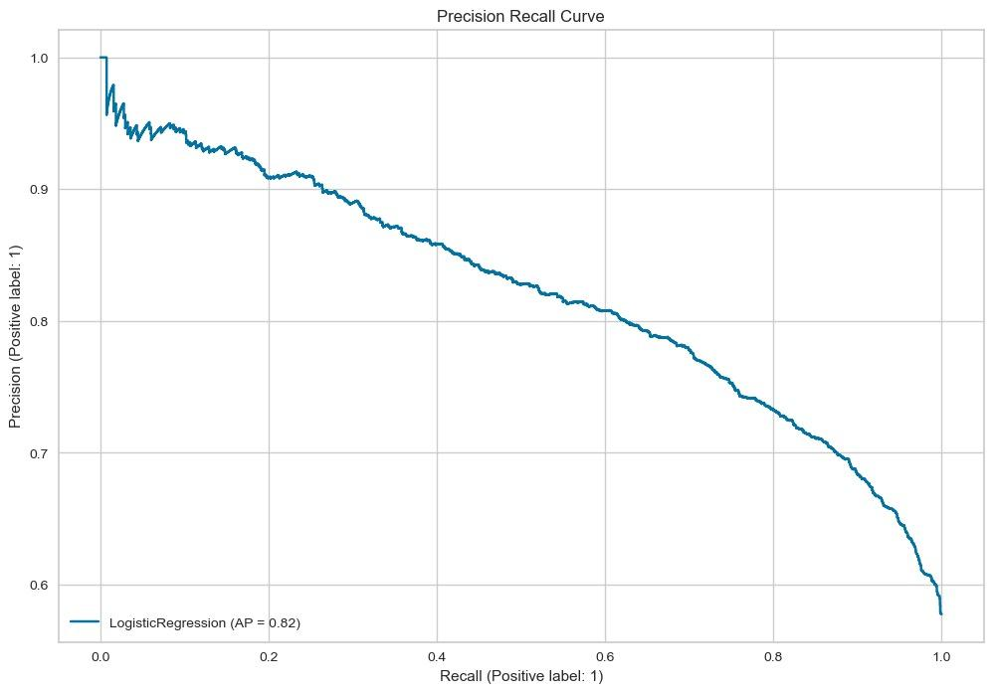
Logistic Regression
One time result:
AUC = 0.78
AP = 0.82

Slide 20
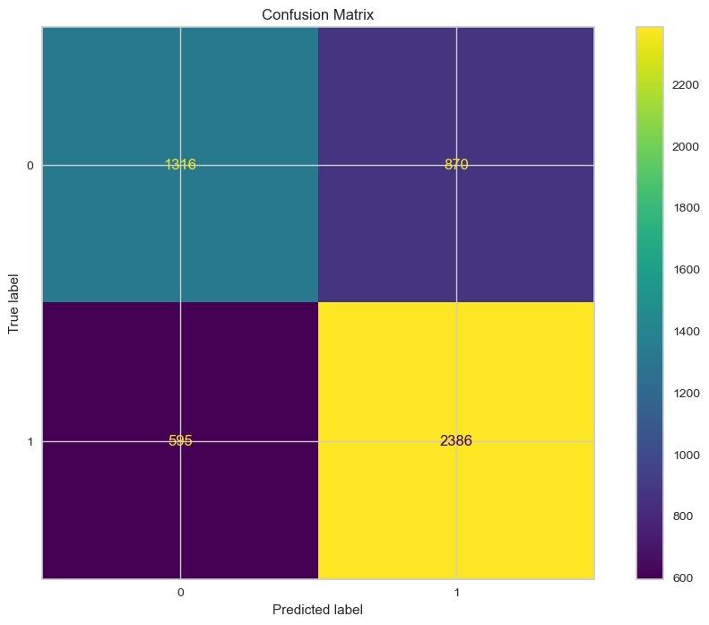
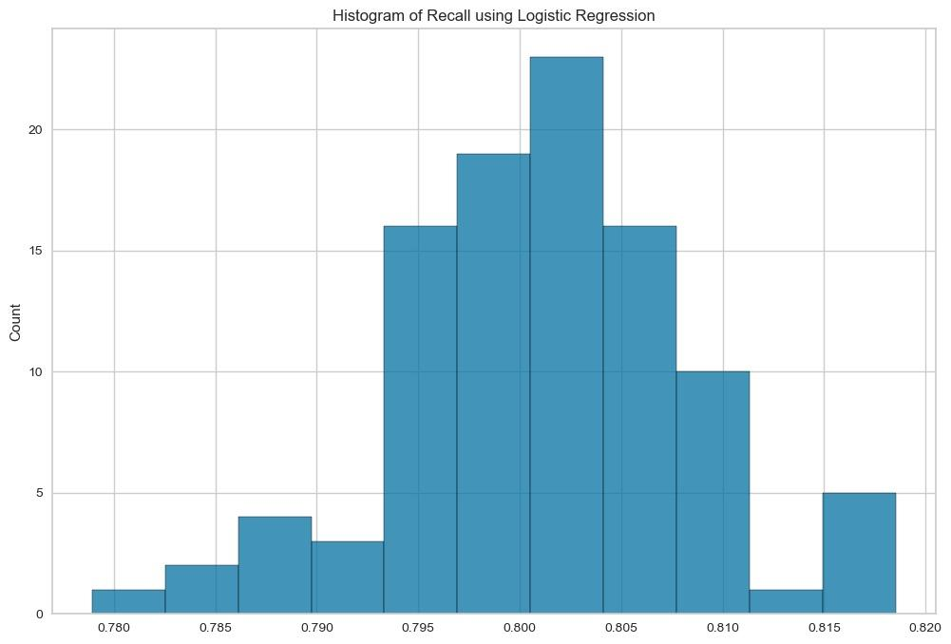
Logistic Regression

Slide 21
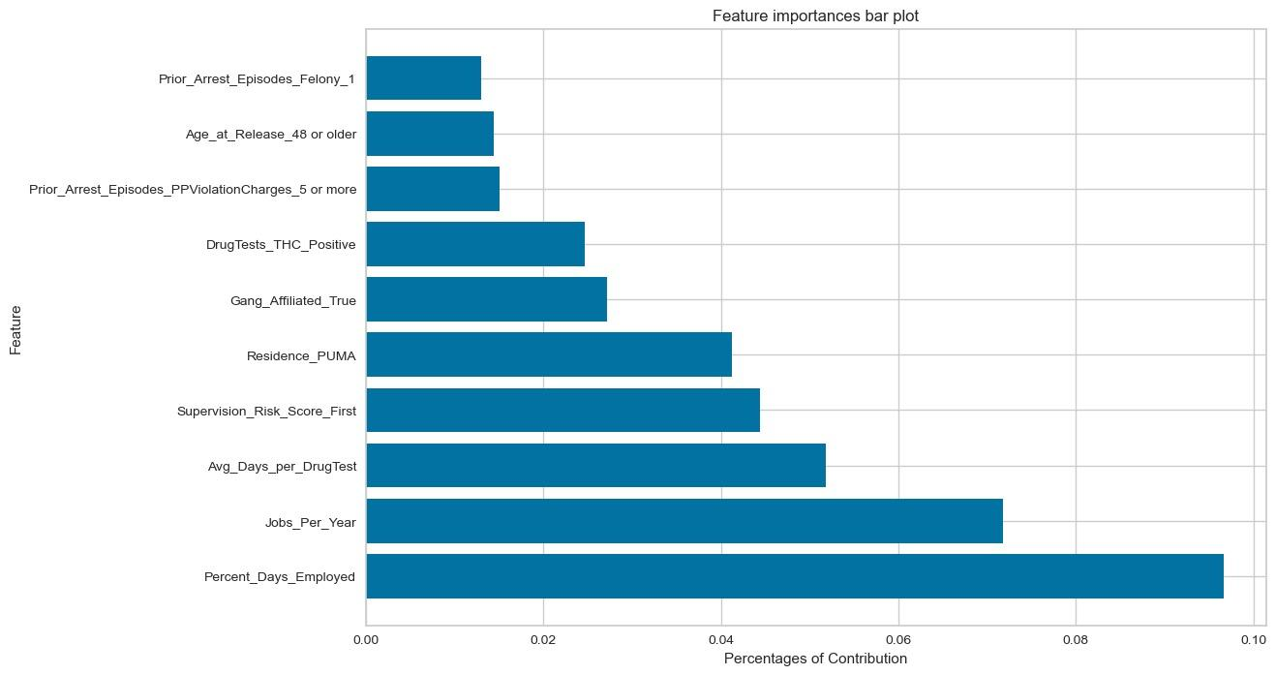
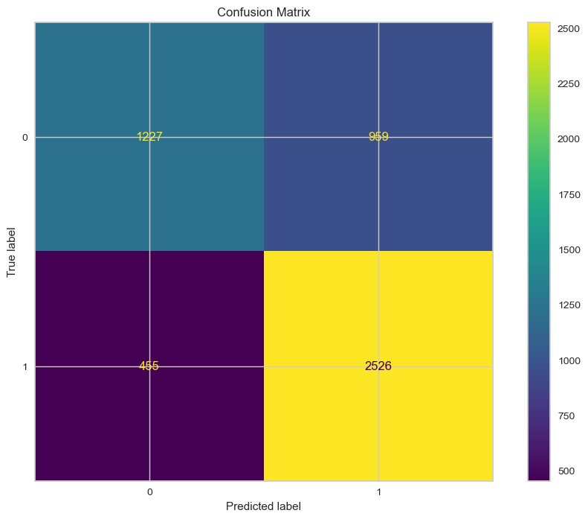
Random Forest
Best hyperparameters:

Slide 22
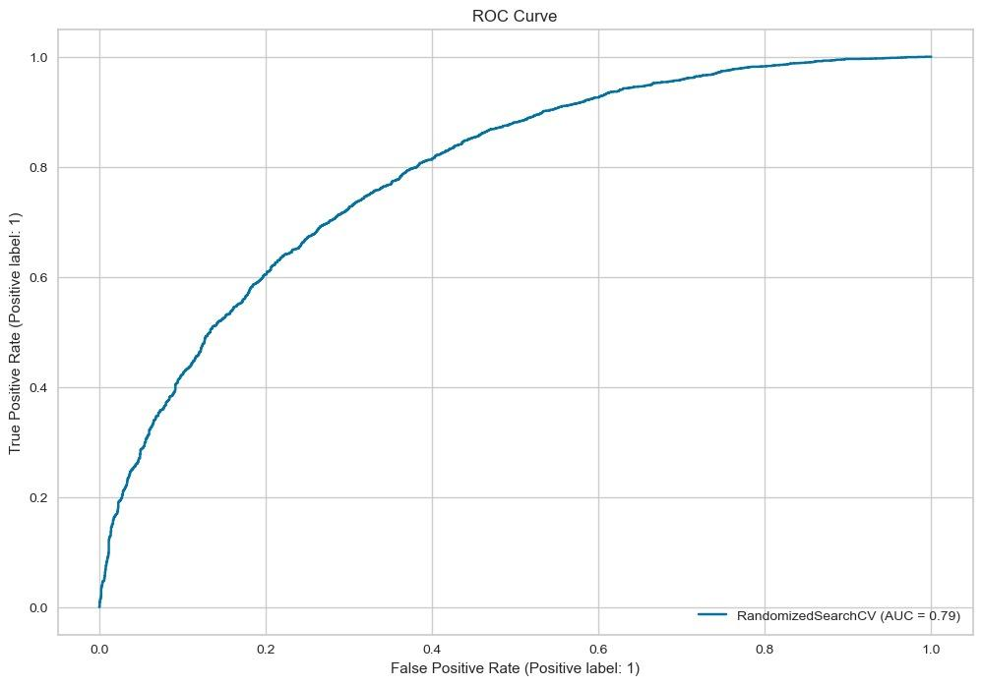
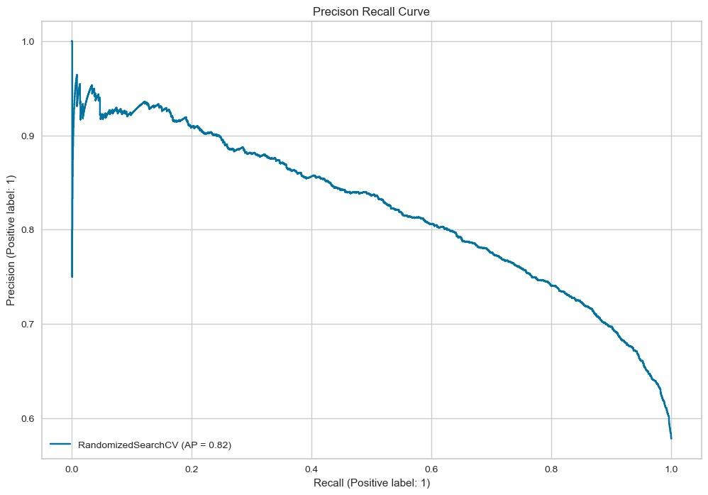
Random Forest
AUC = 0.79
AP = 0.82

Slide 23
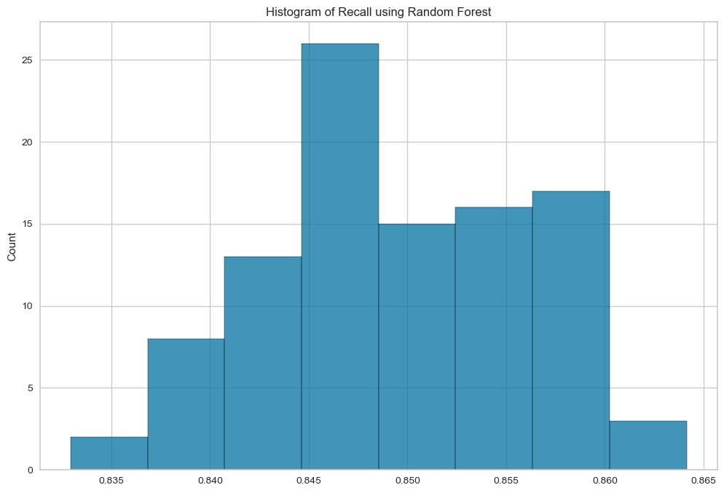
Random Forest

Slide 24
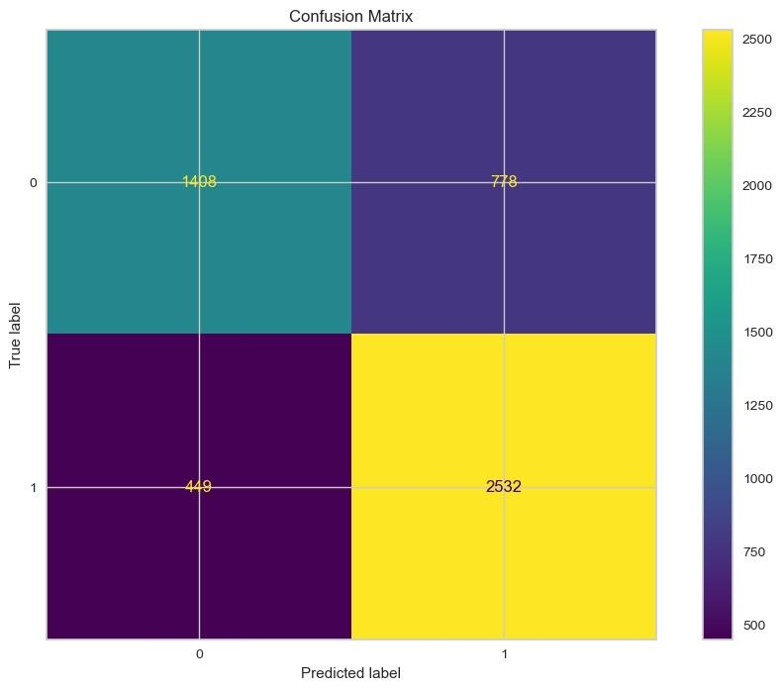
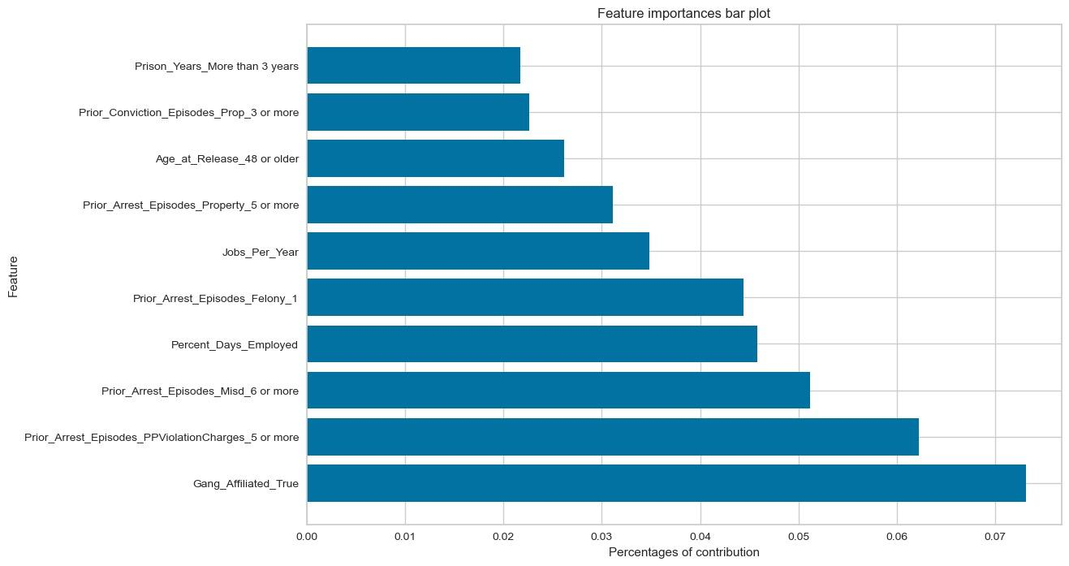
XGBoost
Best hyperparameters:

Slide 25
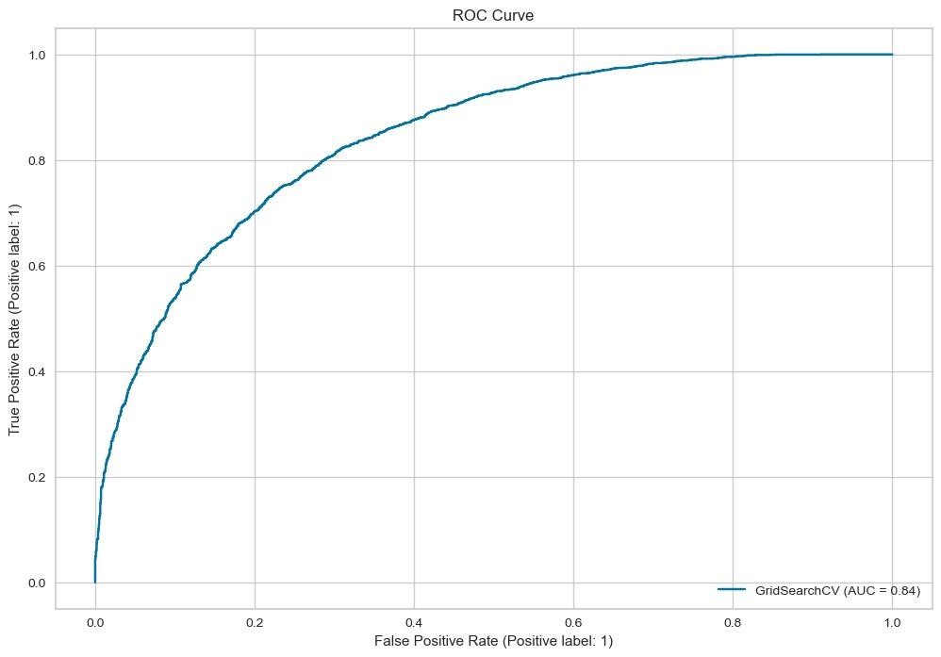
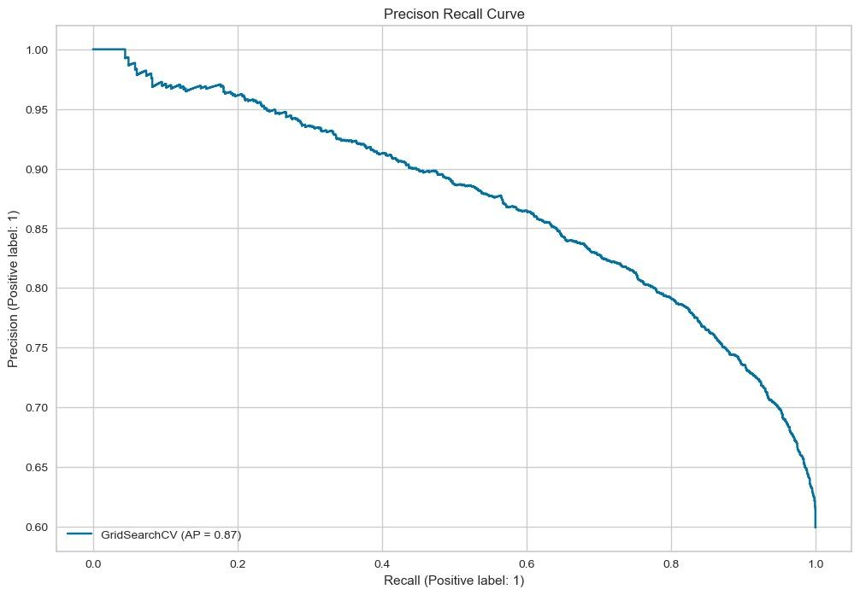
XGBoost
One time result:
AUC = 0.84
AP = 0.87

Slide 26
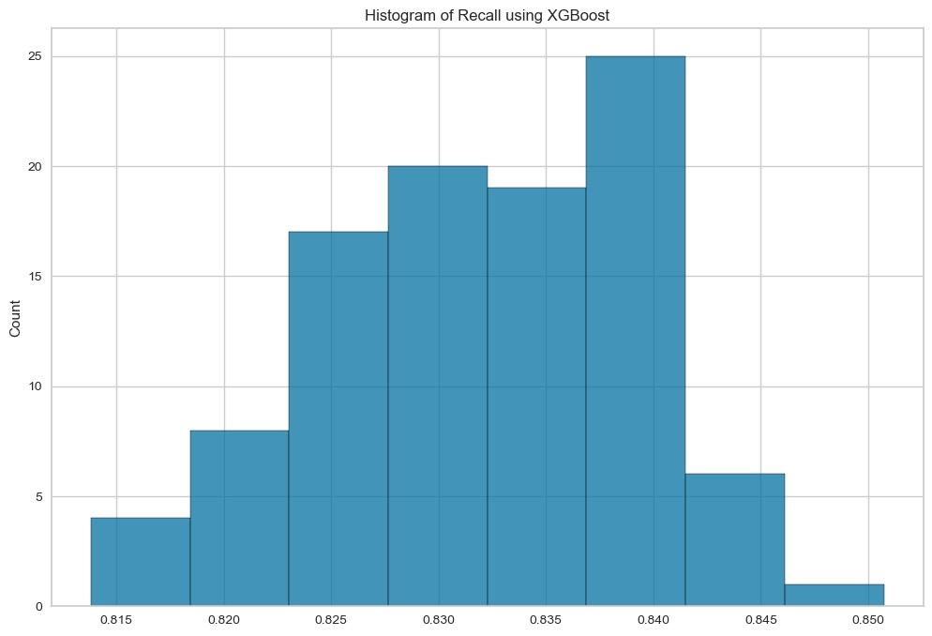
XGBoost

Slide 27
Conclusion & Limitations

Slide 28
Conclusion
The gender, prior crime type, risk score, and education level will somehow affect the recidivation
Improvement in accuracy implies that there exists interaction between covariates
Percent day employed, jobs per year, supervision risk score, and residence PUMA have some predictive power for recidivation in the Random Forest setting
Gang Affiliated, prior arrest PPViolationCharges, prior arrest misdemeanor, percent day employed have some predictive power for the recidivation in the XGBoost setting

Slide 29
Limitations
Limited Variety of Sample (Race)
Some Missing Values (Drug Test result columns)
Hardware Limitation (Random Forest/XGBoost)
Lack of Interpretation

Slide 30
References

Slide 31
References
https://www.kaggle.com/datasets/uocoeeds/recidivism

Slide 32
Thank you!

